Slide 1

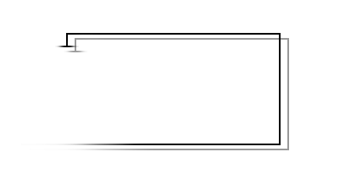
Project: P2P
Group Members: 11910802 Shao Yanwei 11910803 Zhang Ce 11910801 Li Wenyu
From EE Department
2021.12.30

Slide 2
System Design – Communication Protocols
Basic Functions:
Data Transmission:
REGISTER
PClient sends msg = "REGISTER:" + fid, Tracker respond "REGISTER SUCCESS“.
2. DOWNLOAD
PClient sends msg = "QUERY:" + fid, Tracker respond "PORT INFO" + fid + all available ports.
3. CANCEL
PClient sends msg = “CANCEL:" + fid, Tracker respond “CANCEL SUCCESS“.
4. CLOSE
PClient sends msg = “CLOSE:", Tracker respond “CLOSE SUCCESS“.
Querying FILE INFO
Total number of packets
Querying particular packets
(e.g. Packet 0 to packet 100)
Upload packets (with pkt # in pkt)
PClient A (download)
PClient B (upload)

Slide 3
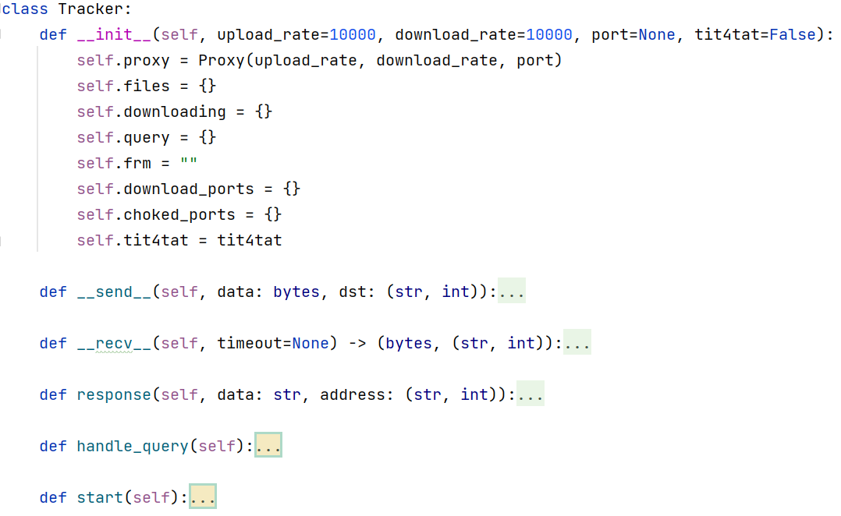
System Design – Structure (Tracker)

Slide 4
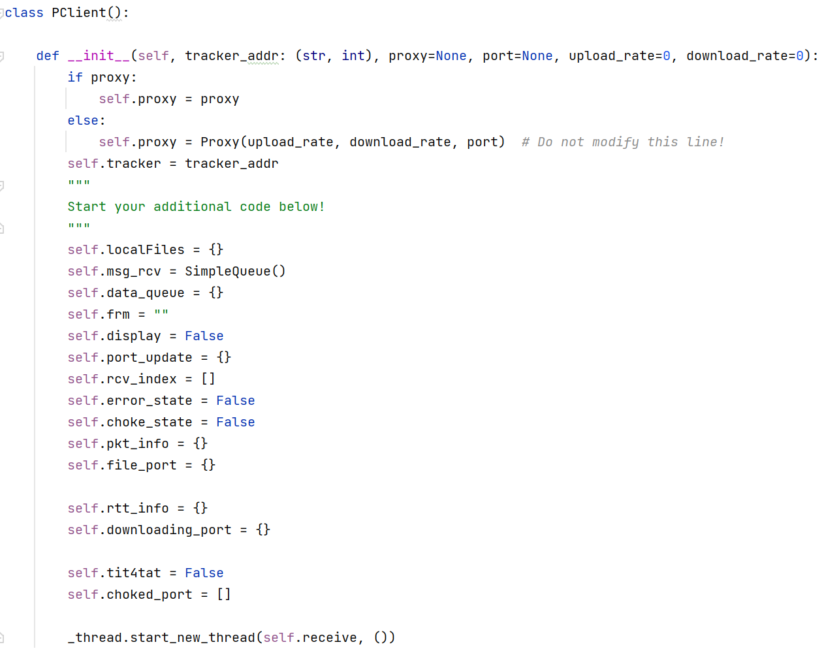
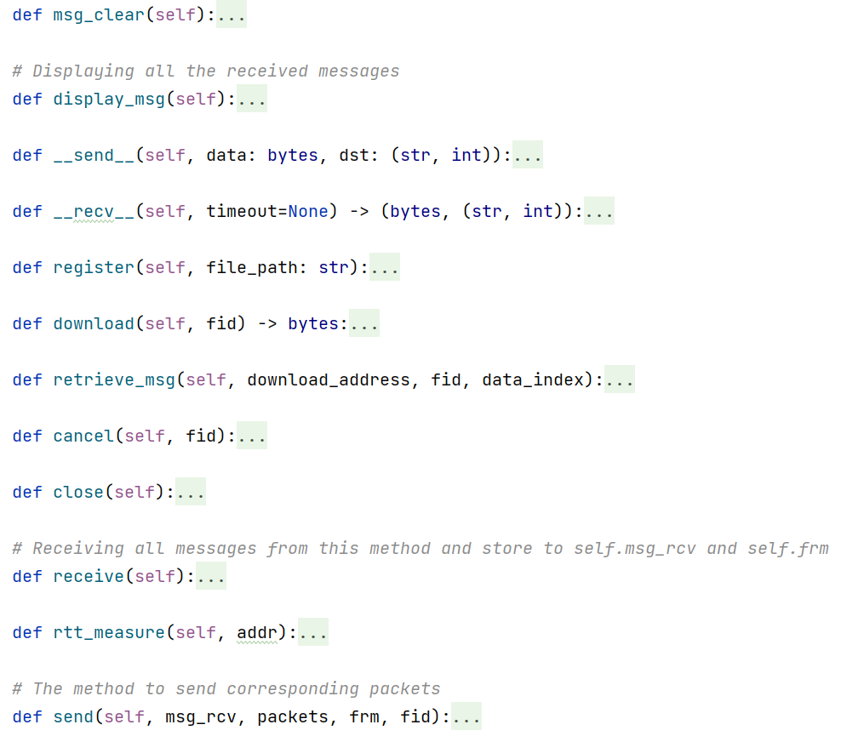
System Design – Structure (PClient)

Slide 5
Methodology - Tracker
1. Use a dictionary to record which PClient has particular file, and record whether it can upload this file.
Example: {{'1384029a1ed513e45d21018286f09fa0': [('("127.0.0.1", 27489)', True), ('("127.0.0.1", 33661)', True)]}}
Meaning: ("127.0.0.1", 27489) and ("127.0.0.1", 33661) have file '1384029a1ed513e45d21018286f09fa0’, can share.
2. Use another dictionary to record the current downloading information (file, uploading PClient, downloading PClient).
Example: {'1384029a1ed513e45d21018286f09fa0': {('127.0.0.1', 27489): [('127.0.0.1', 61512)]}}
Meaning: ("127.0.0.1", 27489) is downloading file '1384029a1ed513e45d21018286f09fa0’ from ('127.0.0.1', 61512).
3. handle_query() function with independent thread, work forever.
It will put the received query message in a SimpleQueue(), when the tracker can deal with new query under the current situation, take the query information in queue (get) and respond to the PClient. (That means we put the queries in queue with order even if there are several queries at the same time.)
4. When a uploading PClient close or cancel, update the new ports to all clients related to this PClient.
Example: if C is downloading the files from A and B, and A cancel this file, then when the tracker receives the cancel message, it will inform C that the new port is B only.

Slide 6
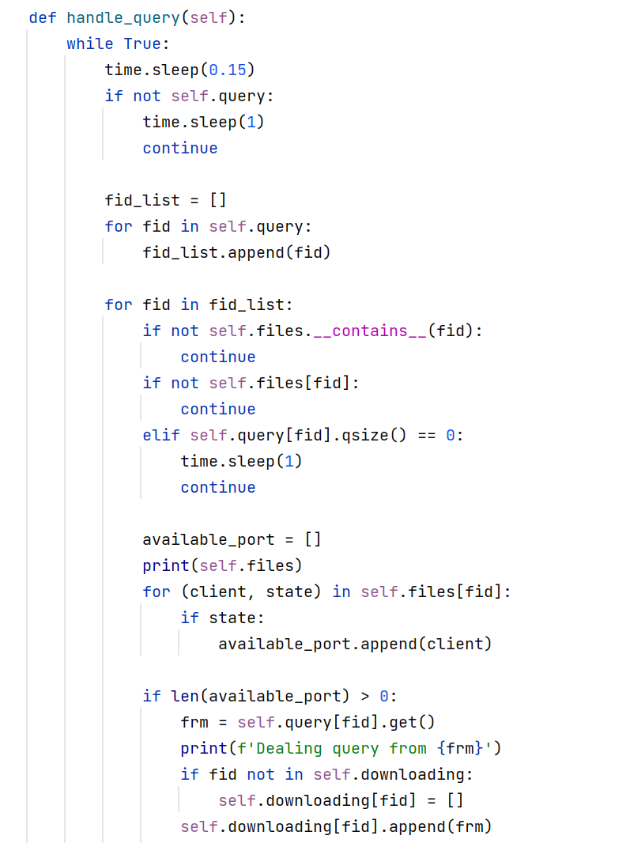
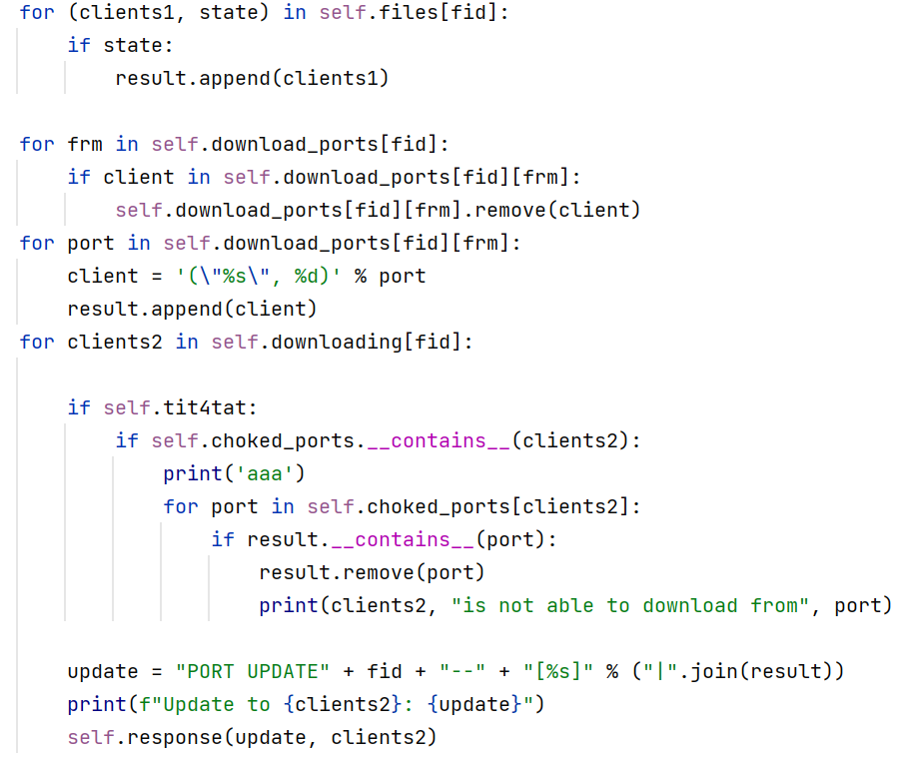
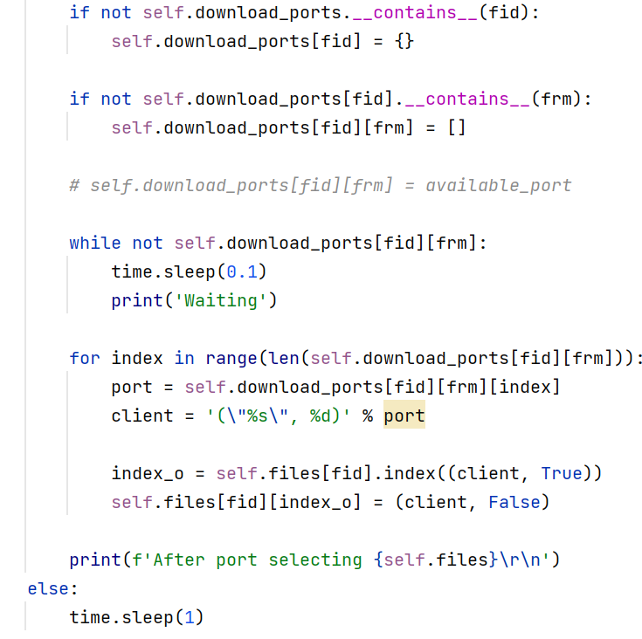
Methodology - Tracker
Port update
handle_query()

Slide 7
Methodology - PClient
1. receive() function with independent thread, work forever.
This method will get every message no matter where it comes from and deal with some of them at once, the rest will be put in to a SimpleQueue(), waiting for further processing.
2. Port choosing. When PClient receives the available port from tracker, it will check the uploading rates of available ports. It will choose several download ports until the total uploading rate is greater than its own downloading rate.
Example:
If the available port A and B has upload rate 100,000 bps, C and D has download rate 100,000 bps. Then C will choose A, leaving B for D, 2 downloading tasks will happen simultaneously.
If the available port A and B has upload rate 40,000 bps, C and D has download rate 100,000 bps. Then C will choose A and B, D will wait until C finishes downloading.
3. Checkpoints and Timers. PClient will set a checkpoint every 100 packets. Timers will record the time starting from the last received packet. If a PClient doesn’t receive any new packets for 5s and the 100 packets are not all received, re-download the 100 packets in this period (from new updated ports).

Slide 8
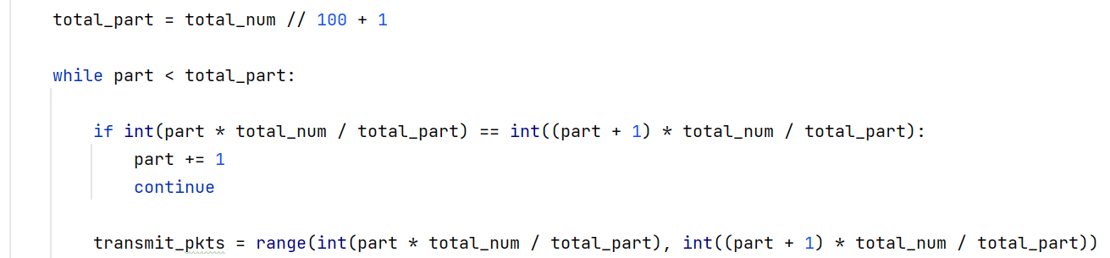
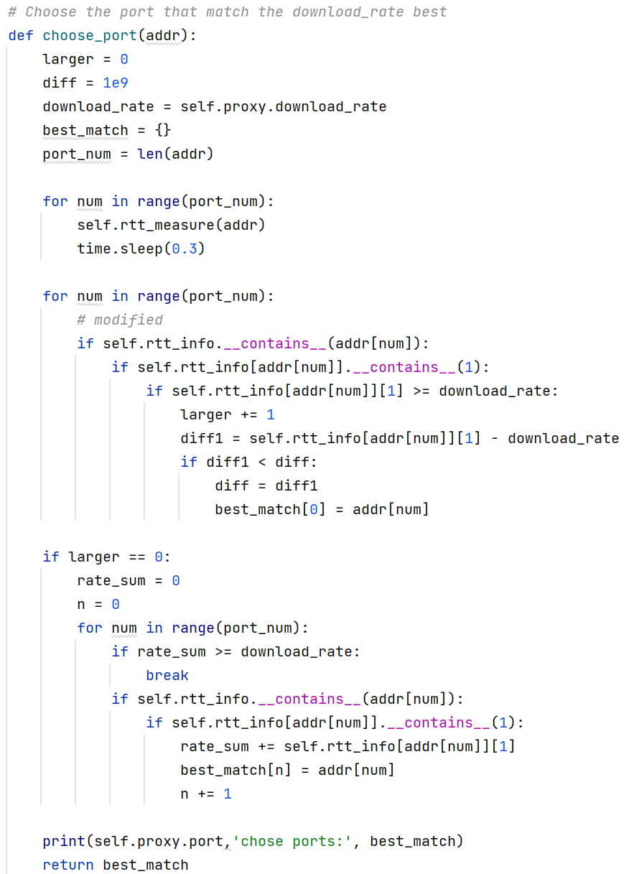
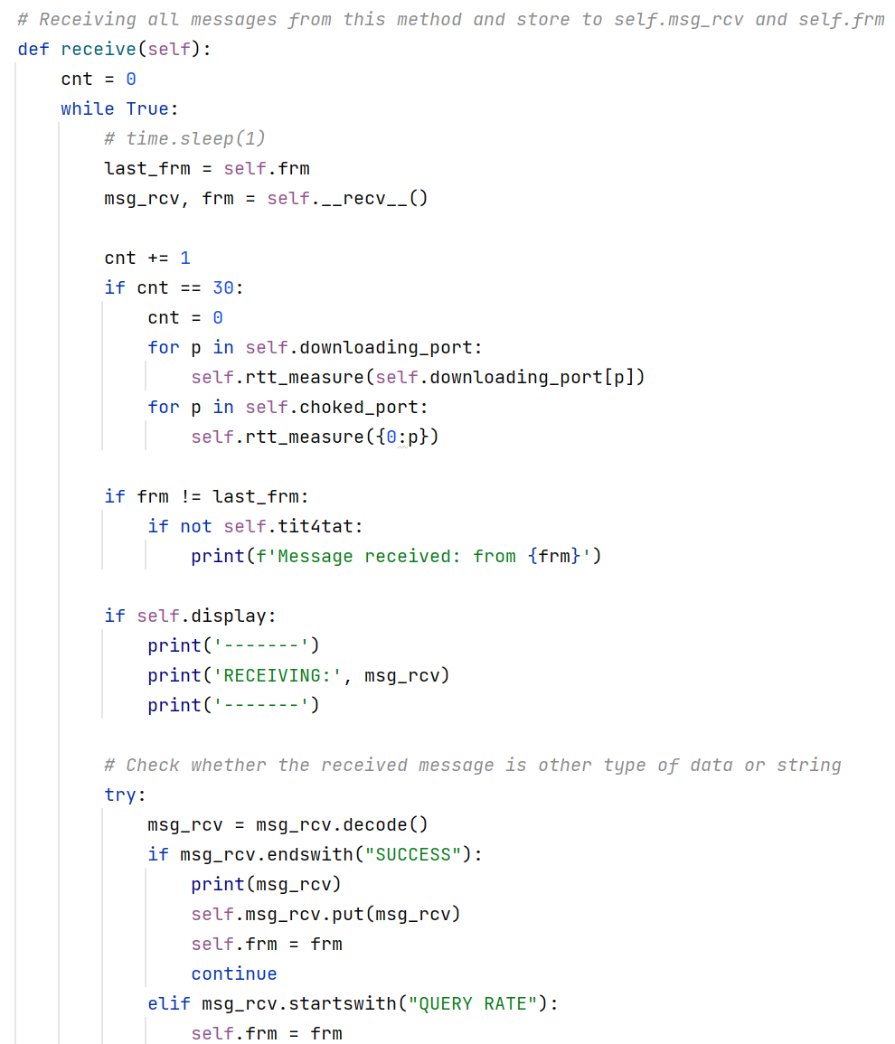
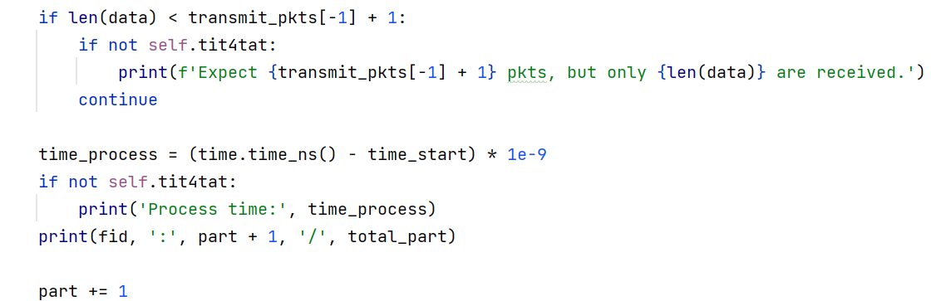
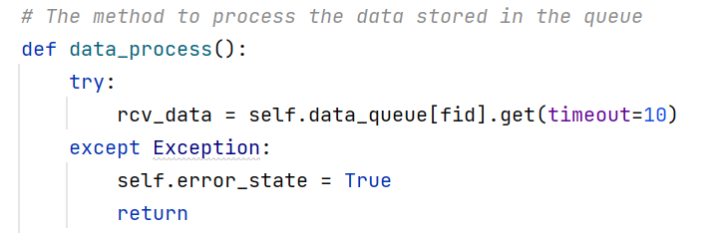
Methodology - PClient
Checkpoint and timer
receive()
Port choosing

Slide 9
Highlights
01
Use queue, solving the problem of multiple queries at once.
Use checkpoints and timers, solving the problem of cancelling and closing during the downloading process. Also alleviating the influence of cancelling and closing to speed.
02
Add pkt # in pkts, assign the desired pkts to different clients and download from multiple clients at once.
03
Port choosing, optimizing the file sharing process, reducing the wastage of uploading rates and maximizing the download speed.
04
05
Appropriate multi-threading design, reducing the processing time during pkts.

Slide 10
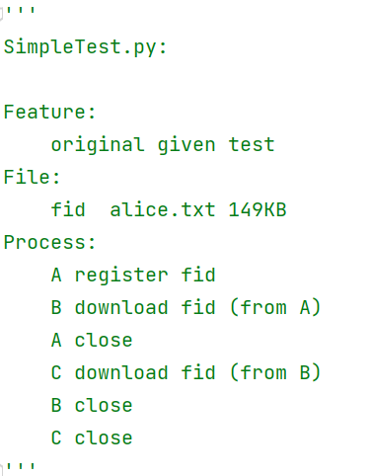
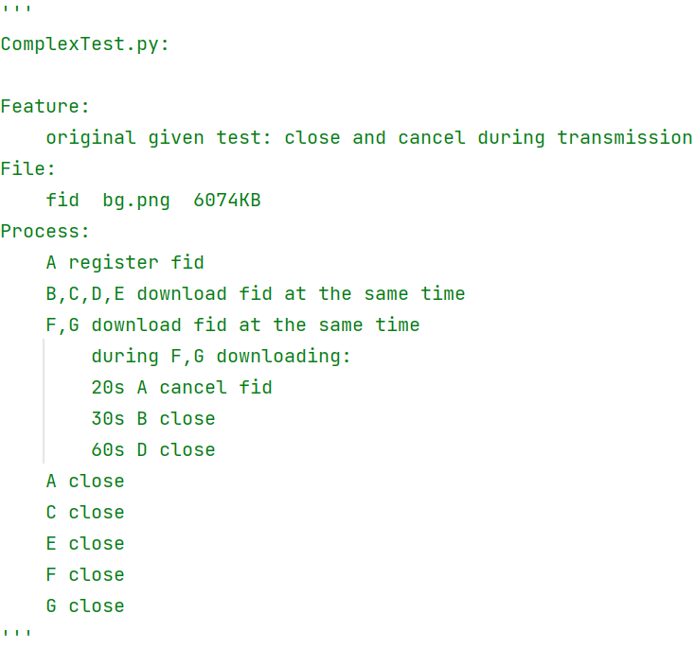
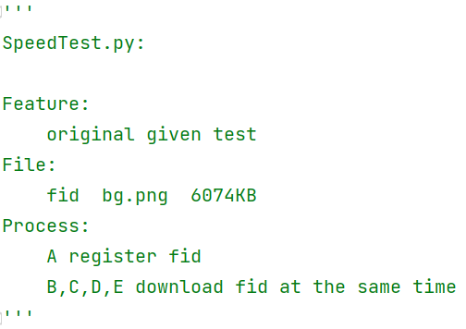

Test Scenarios and Test Results – Given Tests
Simple Test:
Complex Test:
Speed Test:
Time of SC model: 384. 1057625s Time of P2P model: 242.4243768 s

Slide 11
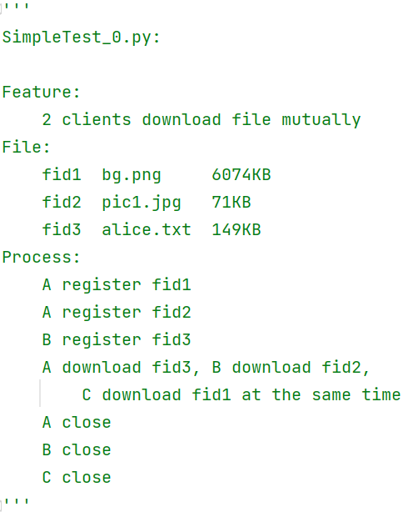
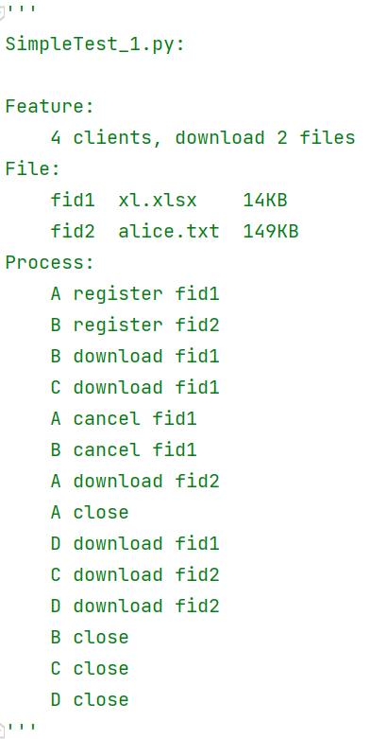
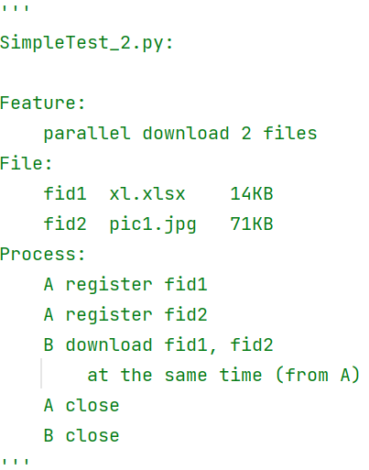
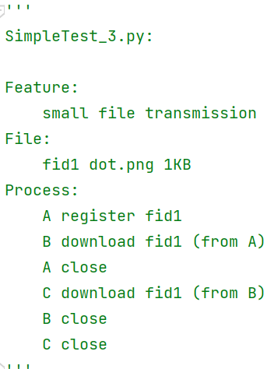
Test Scenarios and Test Results – Self-Designed Tests
Simple Test:

Slide 12
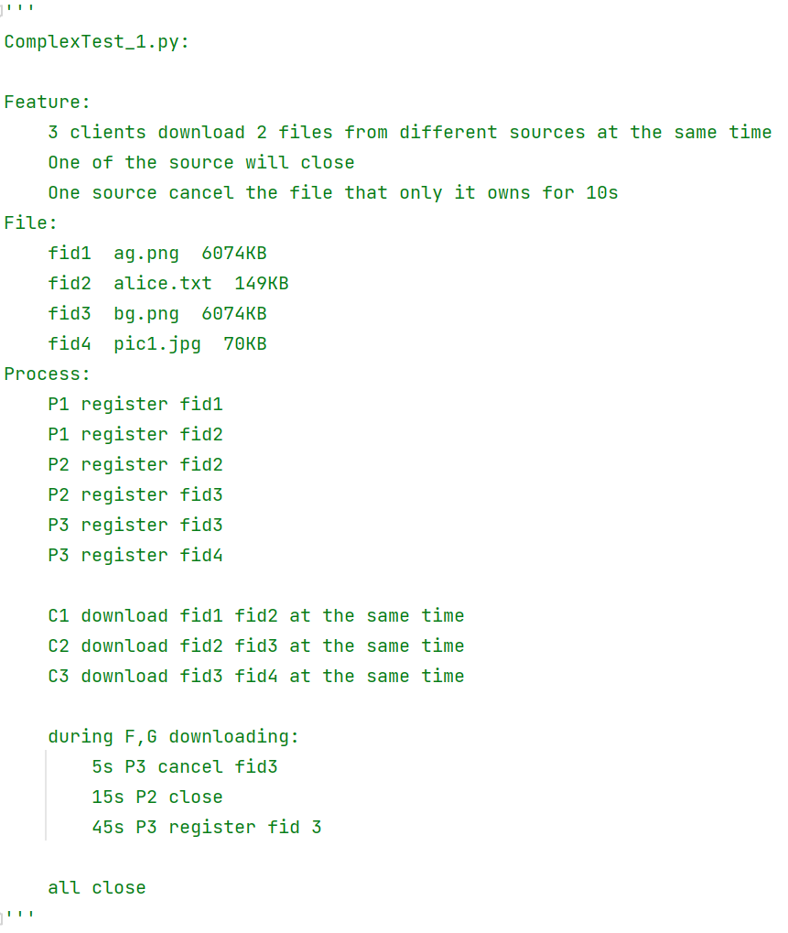
Test Scenarios and Test Results – Self-Designed Tests
Complex Test:

Slide 13
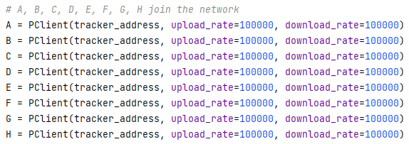
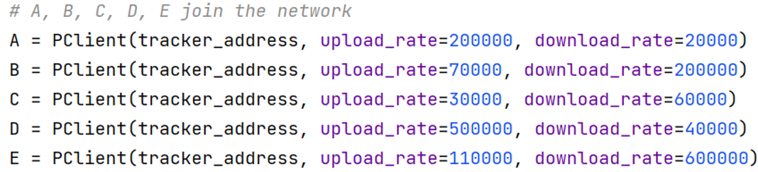
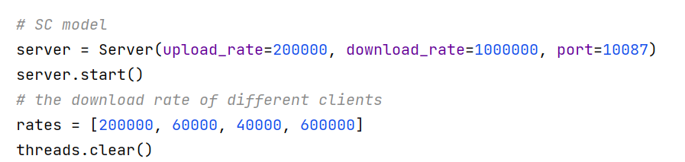
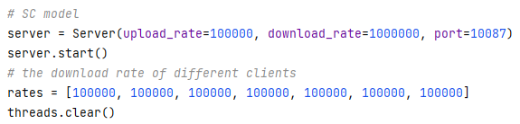
Test Scenarios and Test Results – Self-Designed Tests
Speed Test:
1 -> 8
Complex Situation
Time of SC model: 381 s Time of P2P model: 220 s
Time of SC model: 668 s Time of P2P model: 283 s

Slide 14

Bonus: Tit-for-Tat
Peers Bonding
Clients downloading files mutually will be peers automatically and detect rate of proxy
Choker
This client will delete or add the slow/speed recovered port from its available list
and send message to the tracker.
All reachable ports will be examined when 30 pkts are received.
Tracker
Tracker will send port update information with choker deleted or added
to the choked/unchoke port.
The choker will not be in the available list of the choked client.

Slide 15
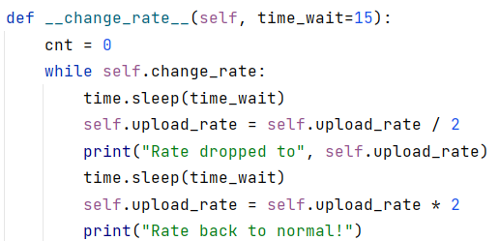
Bonus: Tit-for-Tat
Test Scenarios
Self-Designed Test:
Feature:
The upload rate of Pbad will change frequently
Process:
1.P1 and P2 register fid1
Pbad and Pnormal register fid2
2.P1 download fid2,
Pbad download fid1 simultaneously
Proxy bonus
The upload rate drop/recover every 15s
Expected Result:
1.P1 will choke Pbad and recover
2.The available port of Pbad will
change from 2 to 1 and back to 2

Slide 16
Summary
01
Handle command and requests stably
02
The download speed of P2P models is faster than SC in many cases
03
Port allocation can be designed better according to upload/download rate
04
File can be registered as blocks to improve speed

Slide 17
Thanks for Listening!
Group Members: 11910802 Shao Yanwei 11910803 Zhang Ce 11910801 Li Wenyu
From EE Department
2021.12.30

